Slide 1
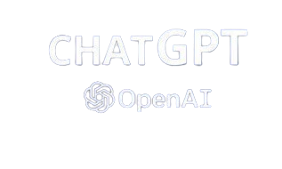
INTERACTION WITH CHATGPT FOR ANALYSIS AND TESTING THE PREFORMANCE

Slide 2
TABLE OF CONTENTS
01
02
03
04
05
Abstract
Methodology
Limitations ans Challenges
Results
Conclusion

Slide 3
01
ABSTRACT

Slide 4
ABSTRACT
In our assignment we will going to test ChatGPT by using three search algorithms in both Arabic and English languages to see how efficient and accurate ChatGPT can generate, repair and summarize a code.
So to accomplish this we will give ChatGPT the whole information we got such as: the algorithms names, what do we need from him to generate, the problem statement that we want from him to solve it with the three algorithms.
The code will be generated in python, and some plots will be provided for the analysis and comparison.

Slide 5
02
Methodolgy

Slide 6
Methodology
So we started our process by trying to understand how does chatGPT understands the things that we write, by asking him few things such as:
If he could remember me after I go to another session and close the current session even when I introduce myself?
If he got feelings of can develop some?
If there is any thing that I can teach it?
How well do chatGPT know the Arabic language?
Or if there is any drawbacks while using Arabic language while we communicate?
After taking the feedback about these question we note that:
chatGPT can’t remember anything after we close the session.
Don’t have any feeling or even can’t develop some.
Don’t have the ability to learn or adapt things.
But he got the opportunity to understand the Arabic language and reply with it, but for sure isn’t perfect and have some drawbacks.

Slide 7
Methodology
After we understand more about it, know we are going to move to our assignment.
So we provided all the information that chatGPT would ask for it, and then we asked to write a python code for the three algorithms in both languages.
After that we asked to give us a more complex code to see how chat can generate the code.
All these were general (the algorithms was solved by a simple array), we tried to give him order to solve these algorithms by a given dataset (iris) and a specific order.
And finally, to see how it performed and compare the both languages results we order chat to use performance metrics and big-O notation for the three algorithms.

Slide 8
04
Limitations and Challenges

Slide 9
Limitations and Challenges
The first question I asked chatGPT was about the limitation and challenges encountered when performing software-related tasks ?
And the respond was :
Understanding context
Specificity and Precision:
Challenge: chat might struggle to maintain context over long conversations, leading to misunderstandings or context shifts.
Limitation: it might not fully comprehend the intricate context of complex software-related discussions.
Challenge: Generating highly specific and precise code or solutions can be challenging.
Limitation: ChatGPT might produce code that works but is not optimized or might not handle all edge cases.
Lack of Real-time Interactivity:
Security concerns:
Challenge: Ensuring secure code generation is challenging.
Limitation: ChatGPT may not be aware of security best practices and might generate code that is vulnerable to security issues.
Challenge: Lack of real-time interactivity hinders dynamic collaboration on code.
Limitation: It doesn't support back-and-forth exchanges as effectively as a human in a live coding session

Slide 10
Limitations and Challenges
The second question I asked chatGPT was about the limitation and challenges encountered include our conversation.
And the respond was :
Language Switching:
Cultural Nuances:
Challenge: Switching between languages in a single conversation can pose challenges in maintaining a coherent context.
Limitation may lead to occasional misunderstandings or context shifts.
Challenge: Understanding and accurately reflecting cultural nuances in language can be challenging.
Limitation: There may be slight variations in interpretation, especially in idiomatic expressions or context-dependent phrases or might not handle all edge cases.
Complexity of Questions:
Challenge: The complexity of questions may affect the depth of responses.
Limitation: In-depth technical or specialized queries might require additional clarification

Slide 11
05
Results

Slide 12
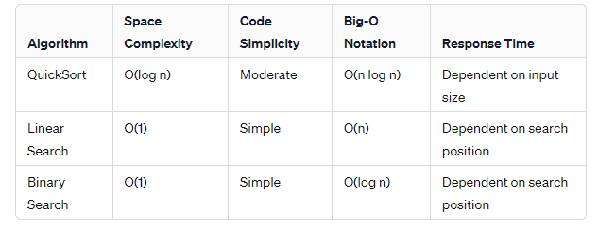
English compare table:

Slide 13
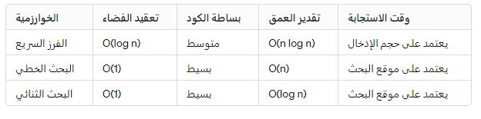
Arabic compare table:

Slide 14
06
Conclusion

Slide 15
Conclusion
This conversation discussed both technical and challenges associated with multilingual interactions, the exchange involved exploring software-related tasks, algorithmic comparisons, and considerations when applying code generated by language models.
The constant switching that we made between the two languages by our conversation demonstrated the model’s versatility in handling diverse linguistic contexts. However, users should remain mindful of potential variations in interpretation due to language nuances.
According to the process that we got through to understand how chatGPT works we understood that we have to provide a detailed information about our problem so chat could provide us a suitable solution and outcomes.
Overall, this analysis highlights the educational value and challenges inherent in language models, emphasizing the need for a balanced and discerning approach by users. As technology evolves, the conversation serves as a snapshot of the current capabilities and considerations in human-machine interactions (chatGPT).

Slide 16

Thanks!
DO YOU HAVE ANY QUESTIONS?

